Slide 1

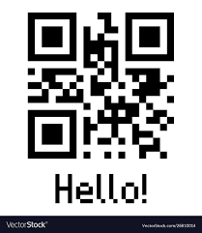
Barcode & QR Code Scanner using Python
Project Plan

Slide 2
01
INTRODUCTION
02
CURRENT STATE OF THE ART
CONTENT
03
METHODOLOGY
04
CONCLUSION

Slide 3
ONE
01
INTRODUCTION
QR & BAR CODES

Slide 4
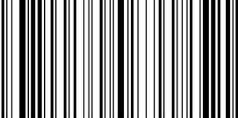
Bar Code and QR Code Scanner
Bar Code
A Bar code is a optical machine readable representation of data relating to object that it is attached.
QR Code
“Quick Response Code” is basically a 2D Barcode with much more redundancy than a 1D Barcode and more storage capacity.

Slide 5
TWO
02
CURRENTSTATE OF ART

Slide 6
PROBLEMS & LIMITATIONS
Image Orientation
The input will be taken by the user’s camera. Hence we can never be sure about the orientation of the image.
Missing Bits
Over time Data gets lost due to physical damage to the code.
Depending upon camera quality and the QR’s Condition, over time there might exist granular texture bits that aren’t part of the code. These noise can cause problem in readability.
Totally depends on the camera on the device. But the older gen cameras’ output leaves much to be desired.
Noise in Image
Image Quality and Illumination

Slide 7
Process Breakdown
Capture from embedded camera device
Execute the barcode reader application
The standard format for 1-D Barcode is EAN - 13 or ISBN - 13. Whereas in the case of QR Codes depending upon number of modules and characters it is of 4 types. Our aim is to design a scanner application that is able to read both 1-D Barcodes and 2-D Barcodes/QR Codes with accuracy by using the camera of our devices (mobile phones and PCs).
The common procedure overview of any barcode scanning application is given
Decode the code
Process the image in DSP
Display the results

Slide 8
LIBRARY SELECTION
OpenCV
OpenCV is a cross-platform library using which we can develop real-time computer vision applications. It mainly focuses on image processing, video capture and analysis including features like Pattern Recognition and object detection.
Since we have to design a Bar Code and QR Code scanner, following “The Ultimate Guide to Barcode Detection - Adrian Rosebrock” we break down the process into smaller parts.
Get the image.
Do some image processing to get the region of Interest.
Draw a Contour around the barcode/QR code area. -Detect Barcode
Decode the Detected barcode.
Display Output.
ZBar
ZBar is an open source software suite for reading bar codes from various sources, such as video streams, image files and raw intensity sensors. It supports many popular symbologies (types of bar codes) including EAN-13/UPC-A, UPC-E, EAN-8, Code 128, Code 39, Interleaved 2 of 5 and QR Code.
To design the whole system in python we can take advantage of several python libraries such as : ZXing, ZBar, Pillow, OpenCV, barcodescanner, matplotlib, numpy, argparse etc.

Slide 9
THREE
03
METHODOLOGY
QR & BAR CODE DETECTION AND DECODING

Slide 10
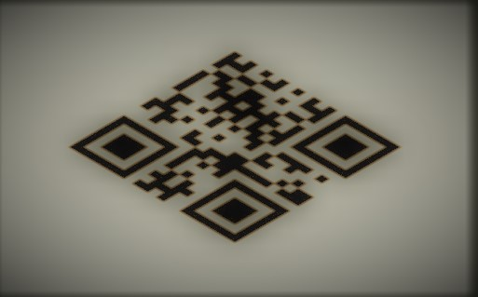

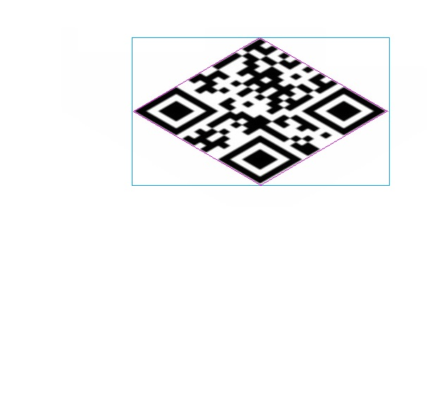
Methodology
Getting The Image
First to get the video feed we start our OpenCV camera by self.cam=cv2.VideoCapture(0)
The self.image captures the frame as Image.
Then we set it such that the frames will keep updating unless and until the pause button is clicked or till we get the output.
Finding the ROI
We will have to do some image processing to get the Region Of Interest here.
First we flip the image.
Then we convert the image into grayscale.
For binarization we convert the image into bgr format texture which comes with inbuilt Otsu’s Binarization method.
Taking advantage of pyzbar library’s inherent function rect and polygon we first draw a rectangle around the most noisy area.

Slide 11
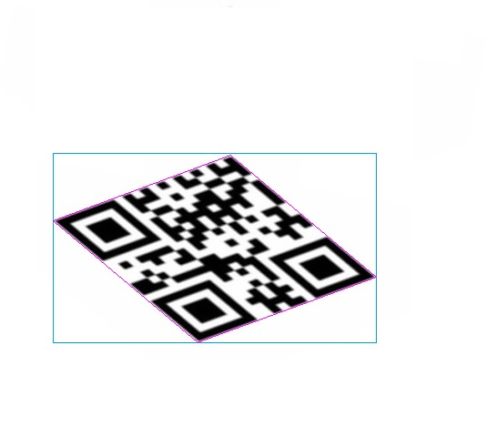
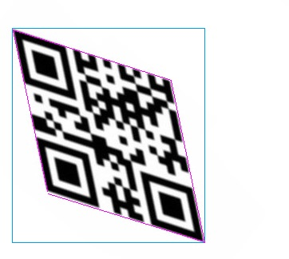
Finding the ROI
The rect function draws a rectangle around the ROI and polygon function draws contour around the subject itself.
The Polygon line morphs trying to fit the rectangle morphing the subject along with it.
The process continues until our decoding algorithm can detect the QR code in it.

Slide 12
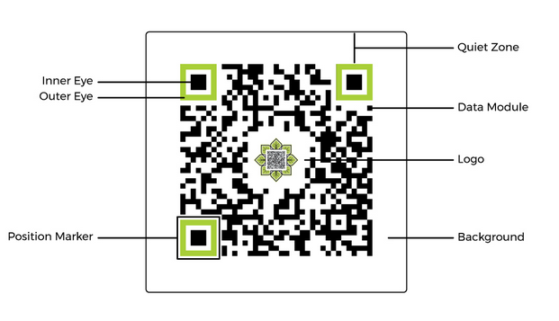
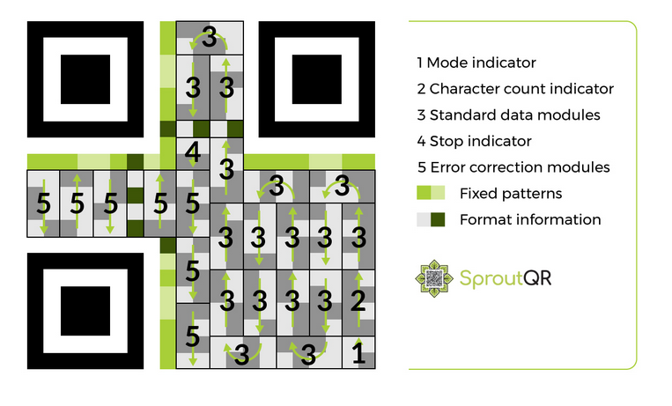
DECODING
Parts of A QR Code
Decoding Step By Step

Slide 13
FOUR
04
CONCLUSION
CONCLUSION

Slide 14
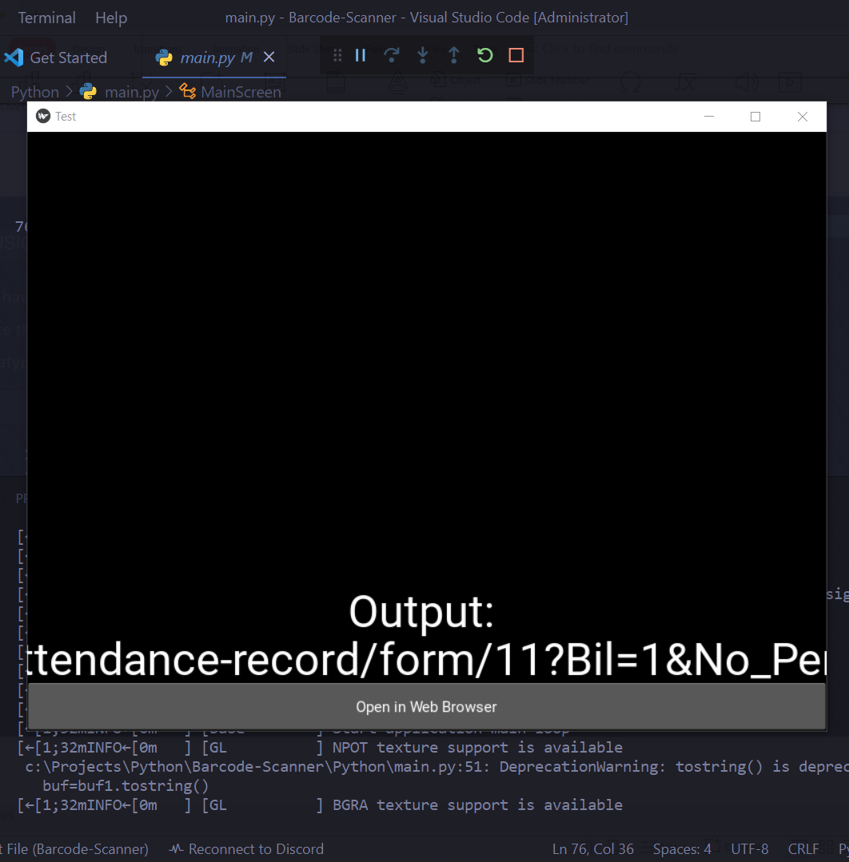
WRAPPING UP
We have used Python Kivy for GUI purposes.
Once the Barcode/QR code is decoded a second screen pops off displaying the data and the datatype.
FUTURE SCOPE
The next focus is to intgrate web browser to the 2nd screen such that the results can be searched online conveniently.
Then we plan to add more functionalities such that depending upon the datatype of the result it will get redirected to specific application/software.
Thank You

Slide 15
REFERENCE
Slide_7- Process_Source: Barcode Readers using the Camera Device in Mobile Phones
by Eisaku Ohbuchi.
Slide_10- Method_Source: Otsu’s Method for Image Thresholding
Slide_12- Image_Source: https://www.sproutqr.com/blog/how-do-qr-codes-work

